Slide 1


Start Smart 1.0
KinDERGARtEN
Lesson 4

Slide 2

ELD Objective
ELD Objective: Students will be able to engage in a Constructive Conversation using the Constructive Conversation Skill of CLARIFY, by taking turns, sharing ideas and making ideas clearer with a partner based on a visual text.

Slide 3
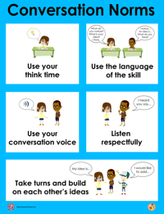
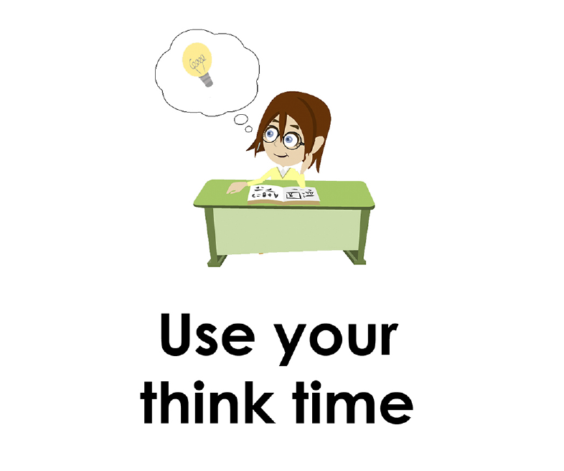
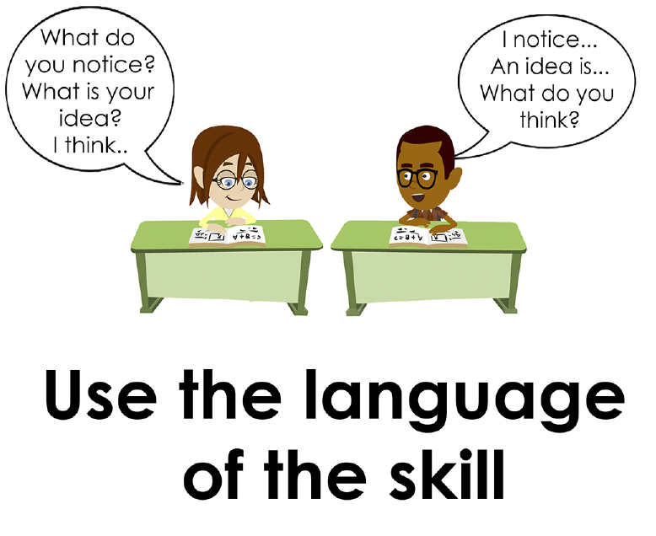
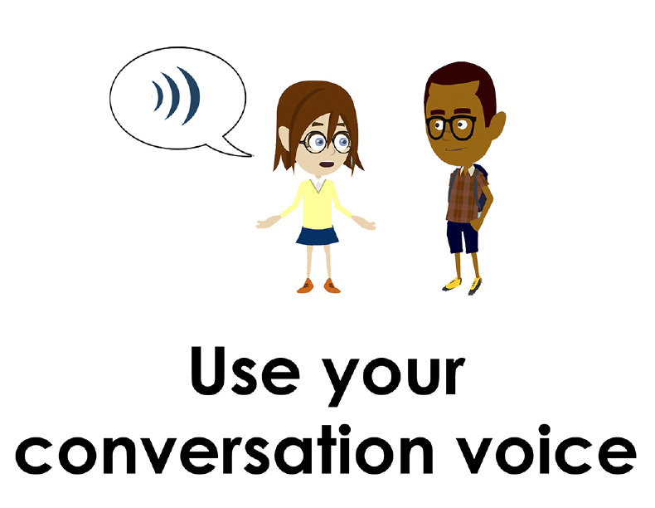
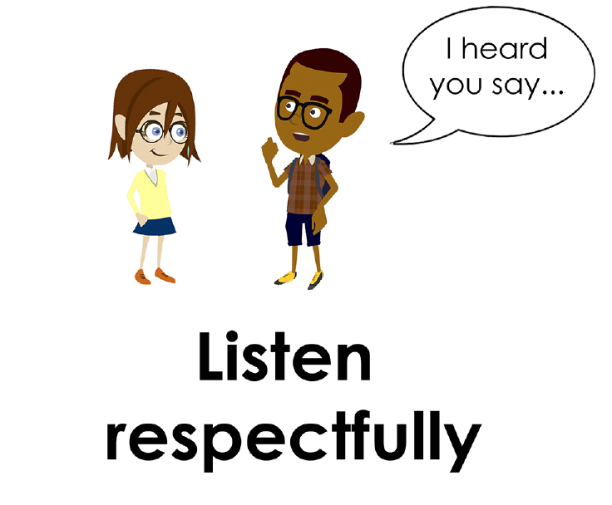
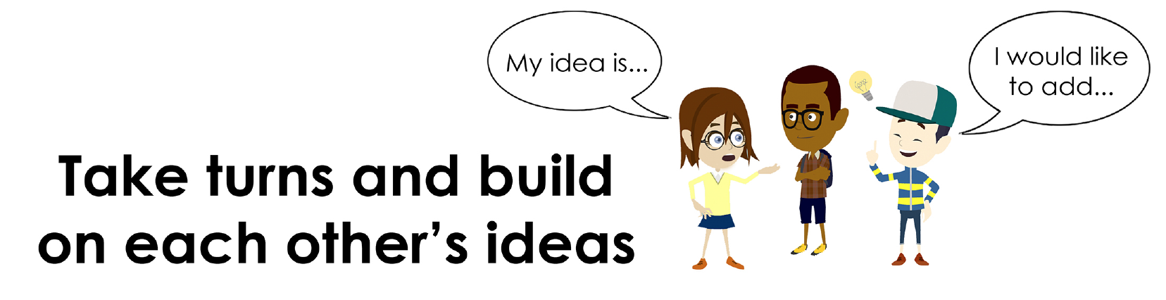
Conversation Norms Poster
  Use your think time
  Use the language of the skill
  Use your conversation voice
  Listen respectfully
  Take turns and build on each other’s ideas

Slide 4
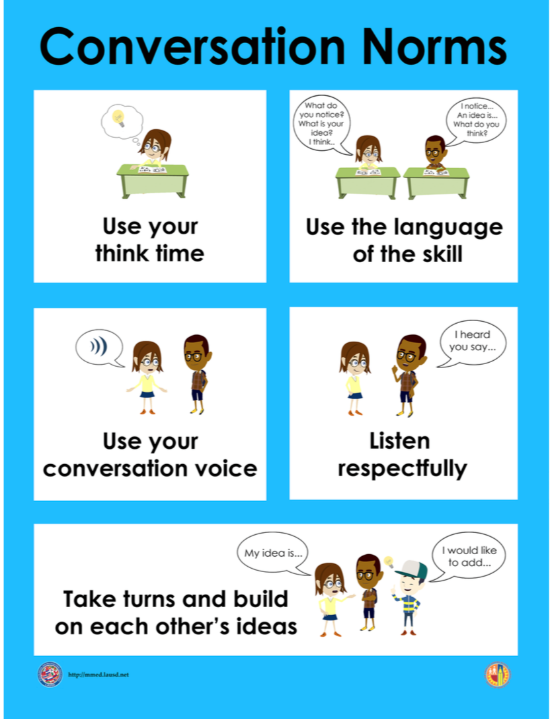
Notes:
The focus today is:
Use your think time
Use the language of the skill

Slide 5
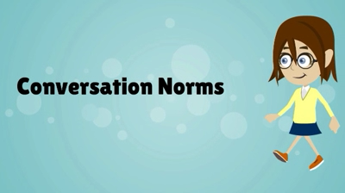
Conversation Norms
Notes:
Show Constructive Conversation Norms Video as a review of all norms

Slide 6
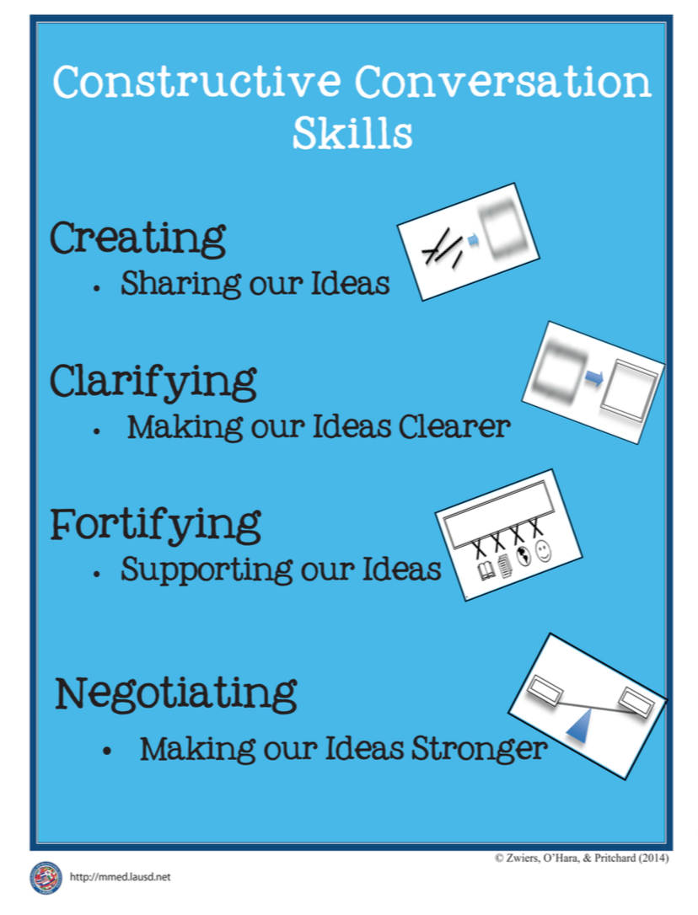
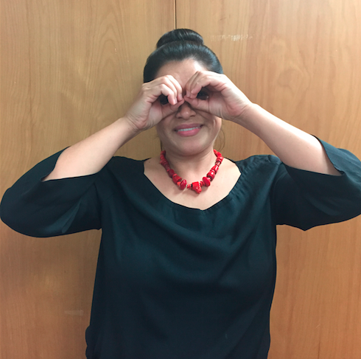
Hand Gesture and Phrase- CLARIFY
Making Our Ideas Clearer
Notes:
Introduce hand gesture for CLARIFY (teacher places his/her hands over eyes and gestures as if “focusing binoculars”).
We use this gesture to explain and make an idea clearer. To help us remember the skill we are practicing we are going to be using a corresponding phrase: “Making our ideas clearer.”

Slide 8
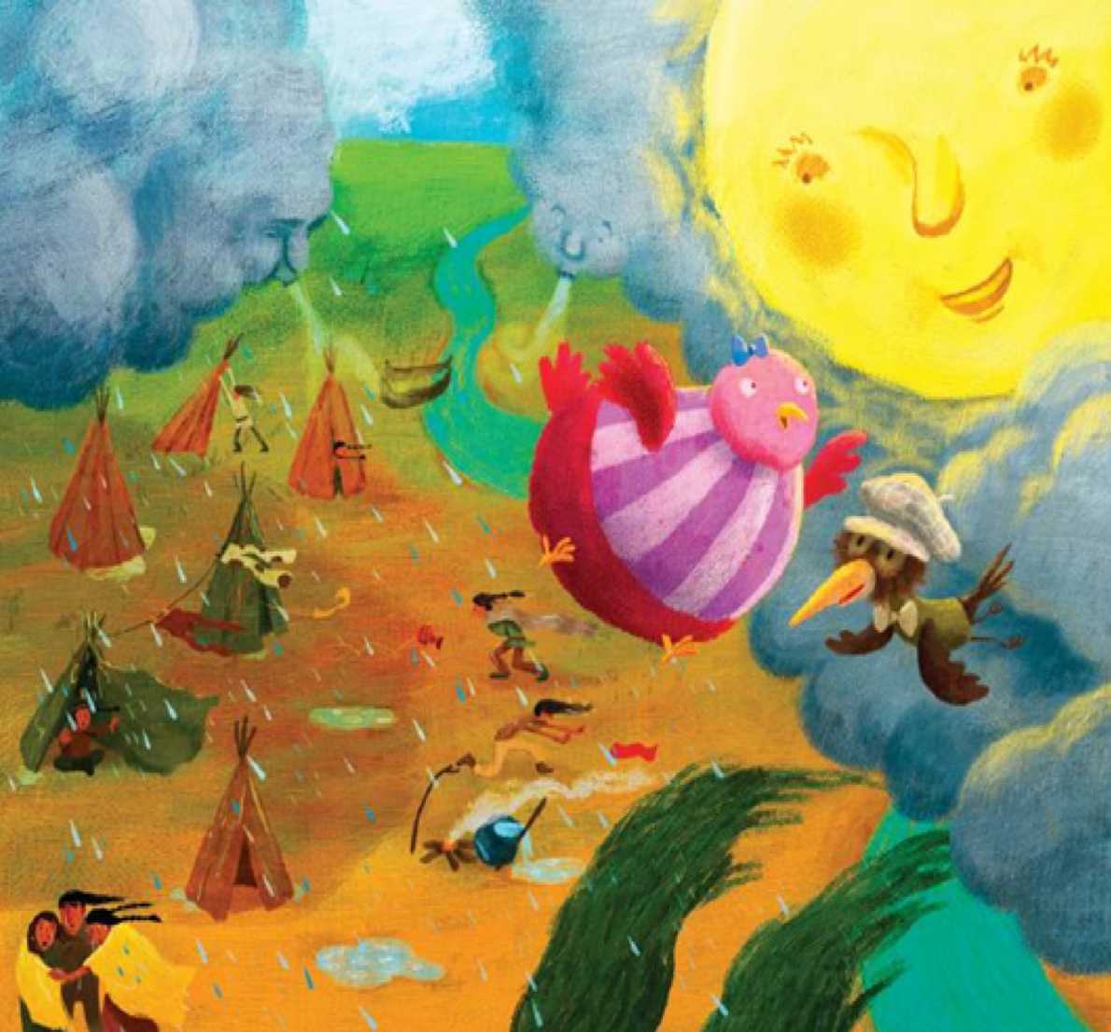
Prompt:
What do you notice in the visual text? Provide details.
TEACHER VISUAL TEXT

Slide 9


Listen to the Model Constructive Conversation
  Use your think time to study the visual text.
Listen actively to what two partners say to each other.
WHAT DO YOU NOTICE IN THE VISUAL TEXT? CITE DETAILS TO CLARIFY YOUR IDEAS.
Notes:
Provide a copy of the Model Script to the volunteer and allow time beforehand for student to review the script. Suggestions for reading the script:
● Show a video of students having the model conversation (optional)
● Student volunteer and teacher read model script
STUDENT LISTEN ACTIVELY

Slide 10
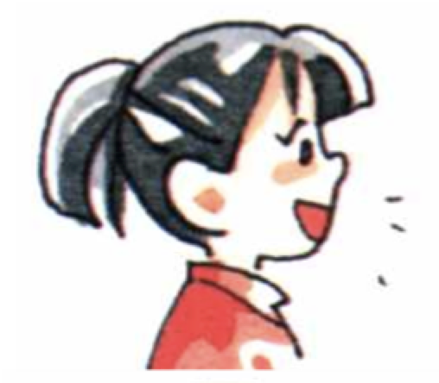
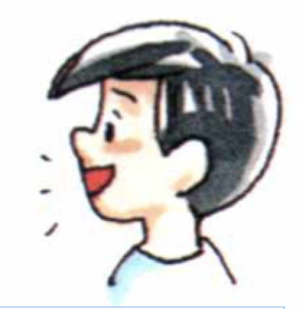
Visual Text Model
What do you notice in the visual text? Provide details.
Partner A: I notice a bird flying. It is wearing a bow tie and a hat. What can you add?
Partner A: I notice the sun is looking and smiling at the bird. What details can you add?
Partner A: I notice a bird with the hat looking at the red bird. What details can you add?
Partner A: I notice three people hugging in the rain. They have a blanket. What can you add?
Partner B: I notice the sun is smiling in the sky. What can you add?
Partner B: I also notice the bird is flying. It is flying in the blue cloudy sky. What can you add?
Partner B: I notice the rain falling. The rain is falling on the people. The people are getting wet. What do you notice?
Partner B: I notice people running. A person is running to the teepee.

Slide 12
Listen to the Non-Model Constructive Conversation
  Use your think time to study the visual text.
Listen actively to what two partners say to each other.
WHAT DO YOU NOTICE IN THE VISUAL TEXT? CITE DETAILS TO CLARIFY YOUR IDEAS.
Notes:
Provide a copy of the Non-­‐‑Model Script to the volunteer and allow time beforehand for student to review the script. Suggestions for reading the script:
● Show a video of students having the model conversation (optional)
● Student volunteer and teacher read model script
STUDENT LISTEN ACTIVELY

Slide 13
Visual Text Non- Model
What do you notice in the visual text? Provide details.
Partner A: I notice the bird with the hat and bow tie is flying.
Partner A: More.
Partner A: I like hats.
Partner A: It is raining.
Partner B: He is looking at the sun.
Partner B: I notice a little hat.
Partner B: I like birds.
Partner B: It is a sunny day.

Slide 14

Constructive Conversation Game
PROMPT:
What do you notice in the visual text? Provide details.
Rules of the game:
Each of you needs 3 CREATE and 3 CLARIFY cards
Each of you will play one card as you share an idea. You will continue taking turns until all cards are placed in the middle.
If you’re done early repeat the process for an additional round.
Remember to use the Constructive Conversation Norms and Skills as you play the game.
Notes:
You are now going to have the opportunity to practice the Constructive Conversation Skill CLARIFY while playing a game.
Explain the rules of the Constructive Conversation Game to students.

Slide 15
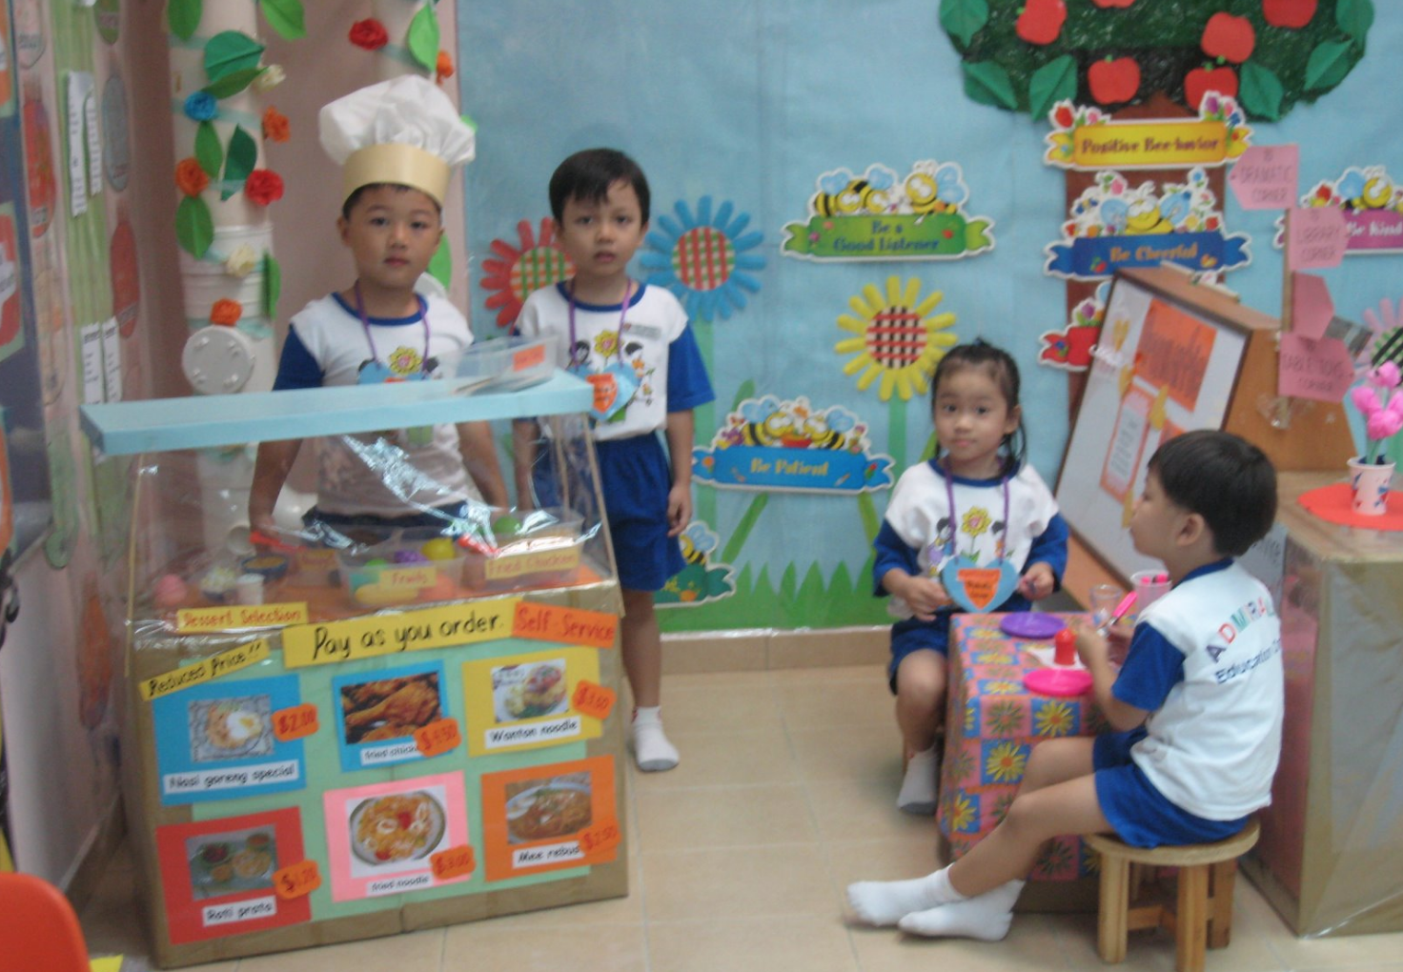

Prompt: What do you notice in the visual text? Provide details.
TEACHER COLLECTS LANGUAGE SAMPLE SPF 1.0
STUDENT VISUAL TEXT
Notes:
Display the Student Visual Text
Direct students to use their Think Time
As the students play the game, the teacher listens and selects two students who will replay the game in front of the class to serve as models.
This is an opportunity to capture a language sample.

Slide 16


CONSTRUCTIVE CONVERSATION
FISHBOWL MODEL
PROMPT: What do you notice in the visual text? Provide details.
Listen actively to what two partners say to each other.
FORMATIVE ASSESSMENT– TEACHER COLLECTS LANGUAGE SAMPLE SPF 1.0
Notes:
The two selected students will replay the game in front of the class and serve as models.
Student Progress Form (SPF)-­‐‑ Constructive Conversation Language Sample The teacher will collect a language sample from the two students on the Student Progress Form (SPF)-­‐‑ Constructive Conversation Language Sample to be used in Lesson 2. The language sample must be at least four turns in length. (Each turn includes both Partner A and B sharing

Slide 17
WRAP-UP
How did we meet today’s objective of using the Constructive Conversation Skill of CLARIFY?
How did you:
    Use your think time?
    Use the language of the skill
  Work with your conversation partner to do the following:
    Identify three things that you did to meet today’s objective
    Share and explain the three things to your partner
Notes:
Teacher will review ELD objective.
Today we engaged in a Constructive Conversation using the Constructive Conversation Skill-­‐‑CLARIFY. We took turns and shared ideas based on a visual text.
Teacher will ask students the following:
● How did we meet today’s objective of using the Constructive Conversation Skill of CLARIFY?
● How did you:
-Use your think time
-Use the language of the skill
● Work with your conversation partner to do the following:
Identify three things that you did to meet today’s objective
Share and explain the three things to your partner
Teacher calls on three students and they tell the class what was done today.

Slide 18
Start Smart 1.0
CLARIFY
Kindergarten
Lesson 5

Slide 19
ELD Objective
Students will be able to revise a Non-Model Conversation for the Constructive Conversation Skill- CLARIFY in a whole group setting and with a triad.
Notes:
Today we are going to review the Constructive Conversation Skill-­‐‑CLARIFY. When we create, we say what we notice about something.

Slide 20
Notes:
Let’s review the Conversation Norms Poster
Today, we will focus on:
Use the language of the skill
Use your conversation voice
**Give examples for both. Ask for student volunteers to model the two norms.

Slide 21
Conversation Norms
Notes:
Show Constructive Conversation Norms Video as a review of all norms

Slide 22
Hand Gesture and Phrase- CLARIFY
Making Our Ideas Clearer
Notes:
Review the hand gesture and phrase for CLARIFY (teacher places his/her hands over eyes and gestures as if “focusing binoculars”).
We use this gesture to explain and make an idea clearer. To help us remember the skill we are practicing we are going to be using a corresponding phrase: “Making our ideas clearer.”

Slide 23
Prompt and Response Starters
Prompt Starters:
What do you notice?
What other details can you add?
What else do you notice?
Tell me more about…
Response Starters:
I notice that…
Another detail I notice…
I also notice…
I would like to add,…

Slide 25
Prompt:
What do you notice in the visual text? Provide details.
TEACHER VISUAL TEXT
Notes:
Display the Student Visual Text
Direct students to use their Think Time

Slide 26
Listen to the Model Constructive Conversation
  Use your think time to study the visual text.
Listen actively to what two partners say to each other.
WHAT DO YOU NOTICE IN THE VISUAL TEXT? CITE DETAILS TO CLARIFY YOUR IDEAS.
Notes:
Provide a copy of the Model Script to the volunteer and allow time beforehand for student to review the script. Suggestions for reading the script:
● Show a video of students having the model conversation (optional)
● Student volunteer and teacher read model script
STUDENT LISTEN ACTIVELY

Slide 27
What makes this a model conversation?
Partner A: I notice a bird flying. It is wearing a bow tie and a hat. What can you add?
Partner A: I notice the sun is looking and smiling at the bird. What details can you add?
Partner A: I notice a bird with the hat looking at the red bird. What details can you add?
Partner A: I notice three people hugging in the rain. They have a blanket. What can you add?
Partner B: I notice the sun is smiling in the sky. What can you add?
Partner B: I also notice the bird is flying. It is flying in the blue cloudy sky. What can you add?
Partner B: I notice the rain falling. The rain is falling on the people. The people are getting wet. What do you notice?
Partner B: I notice people running. A person is running to the teepee.

Slide 28
Understanding the Skill of CREATE and CLARIFY
Partner A: I notice a bird flying. It is wearing a bow tie and a hat. What can you add?
Partner A: I notice the sun is looking and smiling at the bird. What details can you add?
Partner A: I notice a bird with the hat looking at the red bird. What details can you add?
Partner A: I notice three people hugging in the rain. They have a blanket. What can you add?
Partner B: I notice the sun is smiling in the sky. What can you add?
Partner B: I also notice the bird is flying. It is flying in the blue cloudy sky. What can you add?
Partner B: I notice the rain falling. The rain is falling on the people. The people are getting wet. What do you notice?
Partner B: I notice people running. A person is running to the teepee.
Notes:
Understanding the Skill: CREATE and CLARIFY
Teacher displays or distributes the Model Script from Lesson 4.
Let’s look at the Model Script to find evidence of the skills of CREATE and CLARIFY. Are we using the visual text to guide our conversation? Read it to yourself as I read it aloud. Let’s look at the first set of turns.
Example of Think-Aloud:
Student A:
I notice a bird flying. It is wearing a bow tie and a hat. What can you add?
CL
Student B:
I notice the sun is smiling in the sky. What can you add?
CL
Student A:
I notice the sun is looking and smiling at the bird. What details can you add?
CL
Student B:
I also notice a bird flying. It is flying in the blue cloudy sky. What can you add?
CL
Student A speaks and Student B responds. They are taking turns. Now, let’s look at the language of the skill. Look at Student A’s response. How do I know Student A used the skill of CLARIFY? I notice the language of the skill (underline as noted above). I also notice that Student A is stating what they notice in the visual text. I know this is CLARIFY so I will label it with CL because they are providing details (Write CL next to the response.) I also notice that Student B is using the language of the skill to ask a CLARIFY question to get more details, so I will label it with CL (Write CL next to the response and underline as noted above). Student A responds with the language of the skill CLARIFY (underline as noted above). Also, they add more details -based on what they notice in the visual text and ask a CLARIFY question. (underline as noted above).
Teacher prompts student pairs to go through the same process with the rest of the Model Conversation. Students may share their responses in a whole group discussion

Slide 30
Listen to the Non-Model Constructive Conversation
  Use your think time to study the visual text.
Listen actively to what two partners say to each other.
WHAT DO YOU NOTICE IN THE VISUAL TEXT? CITE DETAILS TO CLARIFY YOUR IDEAS.
Notes:
Provide a copy of the Non-Model Script to the volunteer and allow time beforehand for student to review the script. Suggestions for reading the script:
● Show a video of students having the model conversation (optional)
● Student volunteer and teacher read model script
STUDENT LISTEN ACTIVELY
STUDENTS SHOULD LISTEN ACTIVELY

Slide 31
Review Non- Model
What do you notice in the visual text? Provide details.
Partner A: I notice the bird with the hat and bow tie is flying.
Partner A: More.
Partner A: I like hats.
Partner A: It is raining.
Partner B: He is looking at the sun.
Partner B: I notice a little hat.
Partner B: I like birds.
Partner B: It is a sunny day.
Notes:
Review Non-Model
Teacher displays or distributes the Non-Model Script from Lesson 4.
1. Let’s look at the Non-Model Script. How can we improve this Constructive Conversation? This was our prompt, “What do you notice in the visual text. Provide details.” Here’s the visual text. Read it to yourself as I read it aloud. Think about the prompt and the language of the Constructive Conversation skill CLARIFY.
Teacher will use questions and the Listening Task Poster to guide students through an analysis of what makes this a Non-Model Constructive Conversation for the skill of CLARIFY. See possible responses below.
No, they did not take turns sharing their ideas because partner A spoke two times in a row, without letting partner B take a turn
At first, they responded to the prompt, but towards the end they went off topic
They did not build on each other’s ideas
Teacher along with students will revise the text on chart paper or document reader.
Note: Teacher will then proceed to the Non‑Model for the skill of CLARIFY. Suggestions for reading the script:
Have an upper grade student assist with reading the script
Show a video of older students reading the script
Use puppets or dolls to represent the two students
Read the script with another adult
Prompt: What do you notice in the visual text? Provide details.
Non-Model:
Student A:
I notice the bird with the hat and bow tie is flying. (not addressing the prompt)
Student A:
More (speaking out of turn)
Student B:
He is looking at the sun. (not addressing the prompt)
Student B:
I notice a little hat. (not using language of the skill)

Slide 32
REVISE
NON-MODEL
Note to Teacher: Consult pg. 23 of Start Smart 1.0 Lessons or Teacher Resources at end of
Power point
WHOLE-GROUP/CLASS REVISED NON-MODEL
Notes:
Teacher along with students revise the text on chart paper or document reader.
Revised* Non-Model
*text indicates what the teacher should cross out as the text is being revised.
Bold indicates language revised.
Student A:
I notice the bird with the red stripes and the blue bow is flying. What can you add?
Student AB:
I notice the red bird is flying and He is looking at the sun. What can you add?
Student BA:
The sun is smiling at the red bird. Tell me mMore.
Student B:
I notice a little black bird with a hat and a bowtie flying next to the red bird. What can you add?
Refer to class revised Non-Model, have pairs read.

Slide 33
Prompt:
What do you notice in the visual text? Provide details.
Notes:
Display the Student Visual Text
Direct students to use their Think Time

Slide 34

Language Sample Revision-Non-Model
You will work in a triad:
Number off from 1-3 to form a triad and select a student who will record the revision of the language sample
Read the language sample
Orally revise the language sample to improve the conversation
Use the prompt and response starters for CLARIFY
Be prepared to share out to the class
FORMATIVE ASSESSMENT– TEACHER COLLECTS LANGUAGE SAMPLE SPF 1.0
Notes:
Teacher will review ELD objective.
Today we revised a CLARIFY Non-­‐‑Model Constructive Conversation. We took turns and shared ideas based on a visual text.
Teacher asks students the following:
● How did we meet today’s objective of using the Constructive Conversation Skill of CLARIFY?
● How did you:
o use the language of the skill o use your conversation voice
● Work with your conversation partner to do the following:
o Identify three things that you did to meet today’s objective o Share and explain the three things to your partner
Teacher calls on three students and they tell the class what was done today.

Slide 35
WRAP-UP
How did we meet today’s objective of using the Constructive Conversation Skill of CLARIFY?
How did you:
    Use the language of the skill?
    Use your conversation voice?
Work with your conversation partner to do the following:
    Identify three things that you did to meet today’s objective
    Share and explain the three things to your partner

Slide 36
Start Smart 1.0
CLARIFY
Kindergarten
Lesson 6

Slide 37
ELD Objective
ELD Objective: Students will be able to engage in a Constructive Conversation using the Constructive Conversation Skill of CLARIFY, by sharing ideas and taking turns based on a visual text with a partner.
Notes:
Today we are going to practice the Constructive Conversation Skill CREATE. When we observe or read something new we have many thoughts and ideas. As we engage in a CREATE conversation, our job as speakers is to create and take ownership of our ideas. As listeners our role is to value and foster them same or different ideas we hear.

Slide 38
Notes:
Let’s chorally read the Conversation Norms Poster.
Use your think time
Use the language of the skill
Use your conversation voice
Listen respectfully
Take turns and build on each other’s ideas
Today, we will focus on:
Listen respectfully
Take turns and build on each other’s ideas

Slide 39
Conversation Norms
Notes:
Show Constructive Conversation Norms Video as a review of all norms

Slide 41
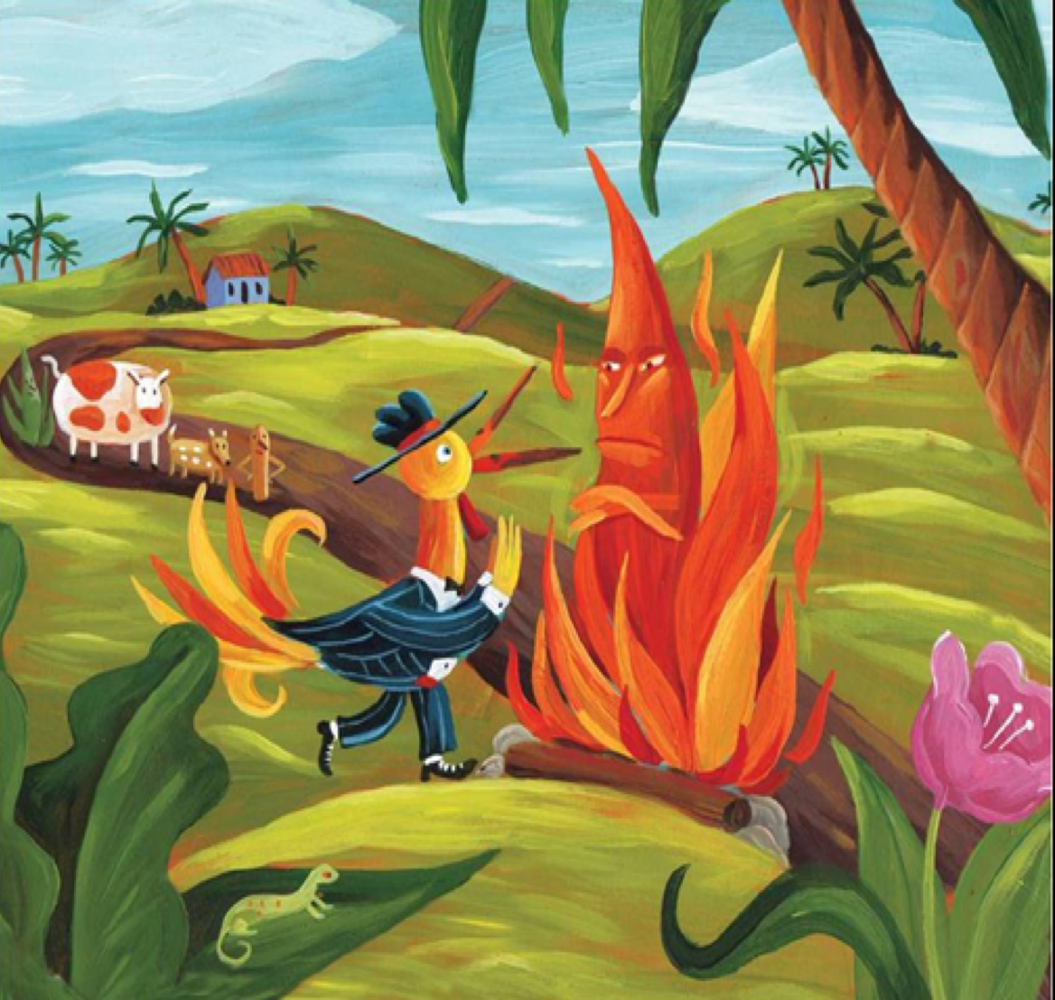
Prompt:
What do you notice in the visual text? Provide details.
TEACHER VISUAL TEXT
Notes:
Display the Student Visual Text
Direct students to use their Think Time

Slide 42
Listen to the Model Constructive Conversation
  Use your think time to study the visual text.
Listen actively to what two partners say to each other.
WHAT DO YOU NOTICE IN THE VISUAL TEXT? CITE DETAILS TO CLARIFY YOUR IDEAS.
Notes:
Provide a copy of the Model Script to the volunteer and allow time beforehand for student to review the script. Suggestions for reading the script:
● Show a video of students having the model conversation (optional)
● Model with a student using the Model Script.

Slide 43
Visual Text Model
What do you notice in the visual text? Provide details.
Partner A: I notice a bird with a blue hat. What can you add?
Partner A: I notice the fire is crossing his arms and looks mad. What can you add?
Partner A: I notice a lizard on the leaf. What can you add?
Partner A: I notice a little dog on the road. What can you add?
Partner B: I notice the rooster is wearing dress up clothes. Tell me more.
Partner B: I notice a cow standing on the road. Tell me more.
Partner B: I notice the rooster has a tail that looks like the fire. Tell me more.
Partner B: I notice a house and tall trees next to the road.

Slide 45
Listen to the Non-Model Constructive Conversation
  Use your think time to study the visual text.
Listen actively to what two partners say to each other.
WHAT DO YOU NOTICE IN THE VISUAL TEXT? CITE DETAILS TO CLARIFY YOUR IDEAS.
Notes:
Provide a copy of the Non-Model Script to the volunteer and allow time beforehand for student to review the script. Suggestions for reading the script:
● Show a video of students having the model conversation (optional)
● Model with a student using the Non-Model Script.

Slide 46
Visual Text Non-Model
What do you notice in the visual text? Provide details.
Partner A: I see the rooster. Tell me.
Partner A: A cow is standing. More.
Partner A: The rooster has a tail. Tell me more.
Partner A: I like hot dogs. What can you add?
Partner B: The fire is mad. Can you add?
Partner B: There’s a lizard.
Partner B: I see a dog.
Partner B: I like hamburgers.

Slide 47
Constructive Conversation Game
PROMPT:
What do you notice in the visual text? Provide details.
Rules of the game:
Each of you needs 3 CREATE and 3 CLARIFY cards
Each of you will play one card as you share an idea. You will continue taking turns until all cards are placed in the middle.
If you’re done early repeat the process for an additional round.
Remember to use the Constructive Conversation Norms and Skills as you play the game.
Notes:
You are now going to have the opportunity to practice the Constructive Conversation Skill CLARIFY while playing a game.
Explain the rules of the Constructive Conversation Game to students.

Slide 48
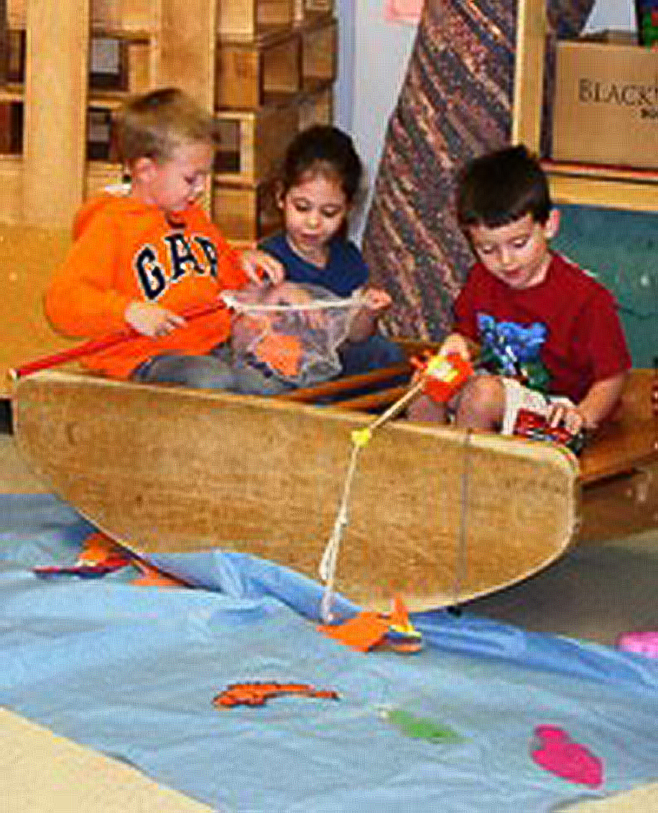
Prompt: What do you notice in the visual text? Provide details.
TEACHER COLLECTS LANGUAGE SAMPLE SPF 1.0
STUDENT VISUAL TEXT
Notes:
Display the Student Visual Text
Direct students to use their Think Time
As the students play the game, the teacher listens and selects two students who will replay the game in front of the class to serve as models.
This is an opportunity to capture a language sample.

Slide 49
CONSTRUCTIVE CONVERSATION
FISHBOWL MODEL
PROMPT: What do you notice in the visual text?
Listen actively to what two partners say to each other.
FORMATIVE ASSESSMENT– TEACHER COLLECTS LANGUAGE SAMPLE SPF 1.0
Notes:
The two selected students will replay the game in front of the class and serve as models.
Student Progress Form (SPF)-­‐‑ Constructive Conversation Language Sample The teacher will collect a language sample from the two students on the Student Progress Form (SPF)-­‐‑ Constructive Conversation Language Sample to be used in Lesson 2. The language sample must be at least four turns in length. (Each turn includes both Partner A and B sharing

Slide 50
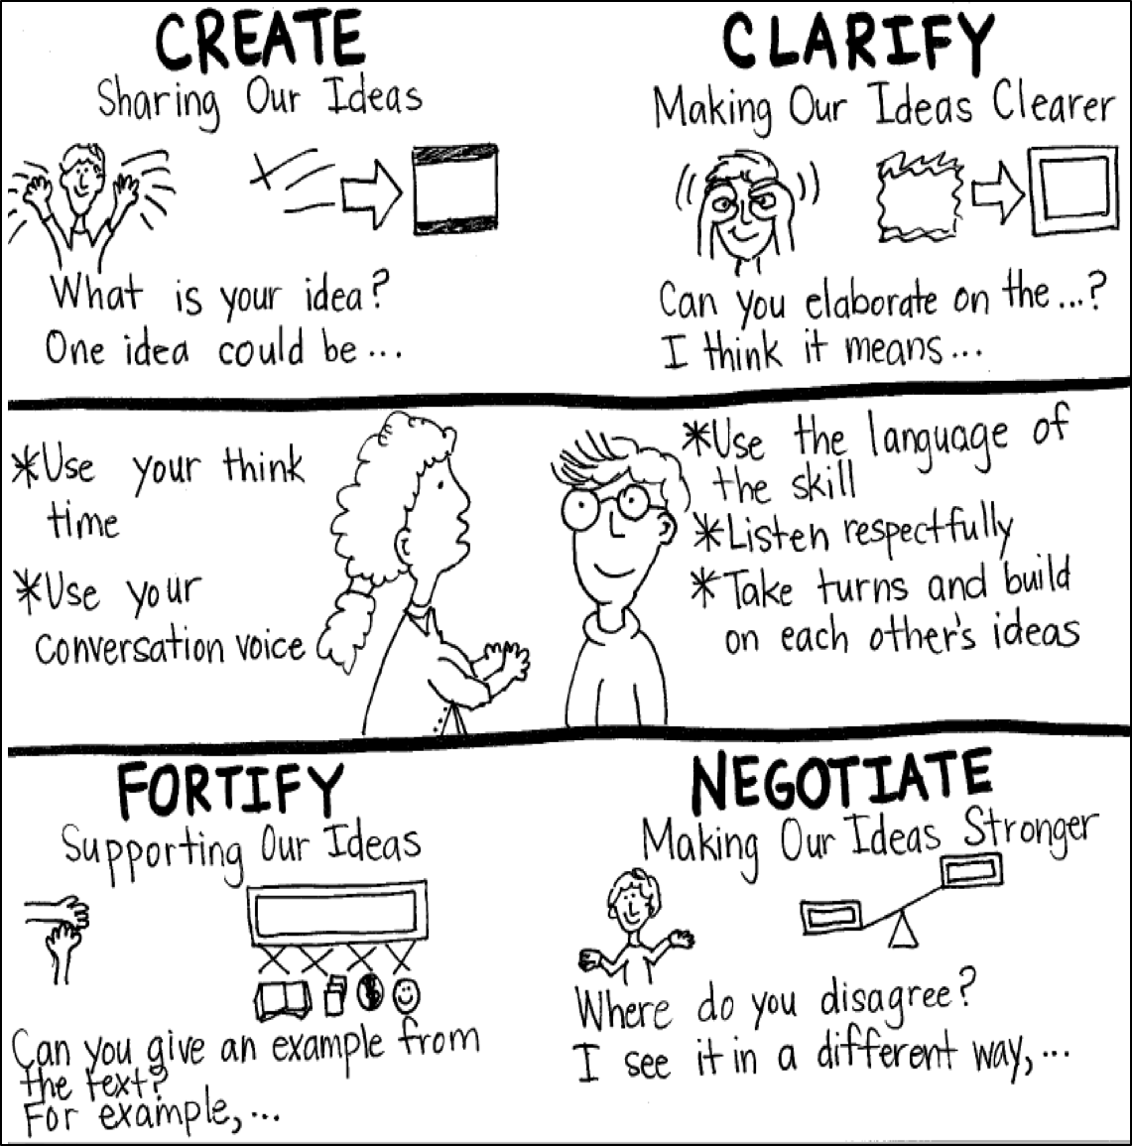
Model Creating Class Constructive Conversation Poster
Sample
Notes:
Teacher models creating a Constructive Conversation Poster. This slide is a resource. Teacher elicits student responses to help student develop a poster that illustrates their understanding of the CLARIFY skill and conversation norms.

Slide 51
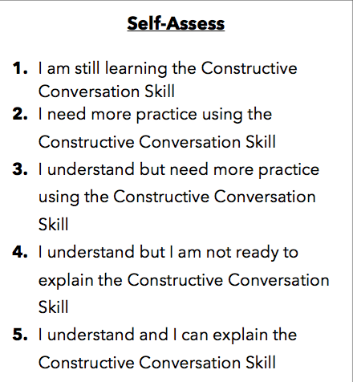
Notes:
Teacher will review the Constructive Conversation Skill CLARIFY
Students will self-assess answering the prompt
Teacher may select a conversation pair to share out.
EXAMPLE:
Student: I rated myself a 3 because…
Teacher: What can you do to move to a 4?

Slide 52
Teacher Resources

Slide 53
CLARIFY Non-Model Revision

